Slide 1
Deep Learning Framework for structural analysis of single particle cryo-EM maps
Research Proposal
Mark Rozanov
Supervisor: Haim J. Wolfson

Slide 2
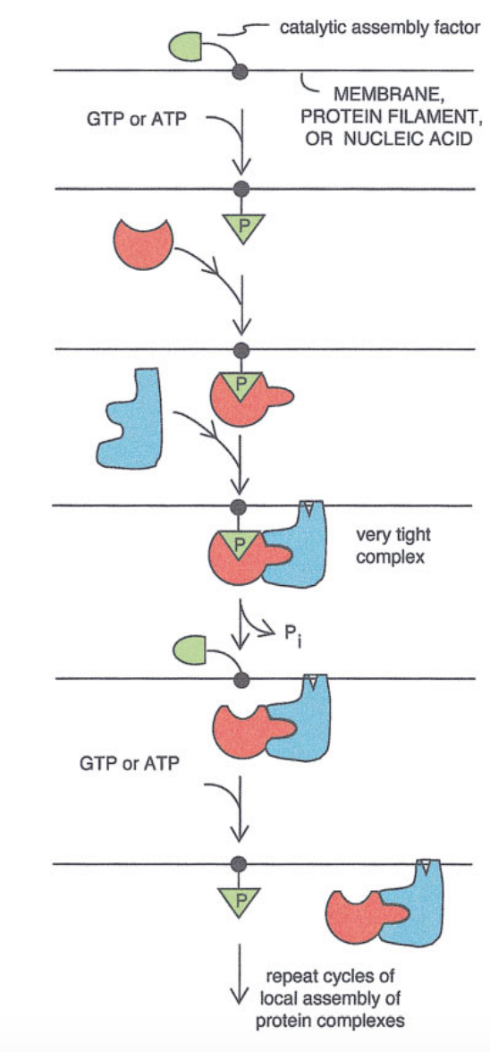
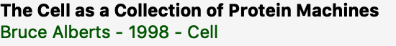
IntroDUCtion: GENERAL
Cell is A COLLECTION OF PROTEIN MACHINES
Proteins make up most of the dry mass of a cell
nearly every major process in a cell is carried out by assemblies of 10 or more protein molecules
The entire cell can be viewed as a factory that contains an elaborate network of interlocking assembly lines, each of which is composed of a set of large protein machines

Slide 3
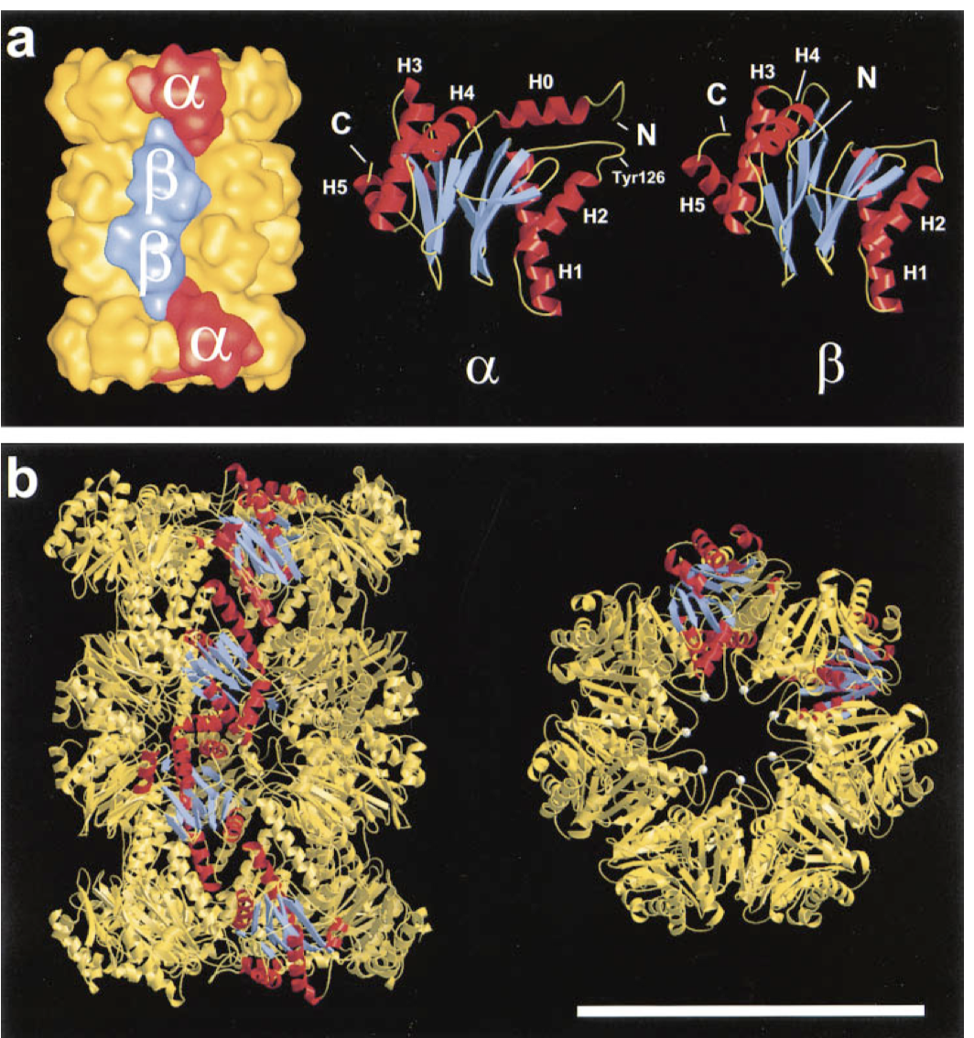
IntroDUCtion: GENERAL
Structural characterization of macromolecular assemblies represents a major challenge in structural biology.
An incredible array of functions derives from a startlingly simple code that specifies a hugely diverse set of structures.
The function and dynamics of an assembly is derived from its detailed atomic structure.

Slide 4
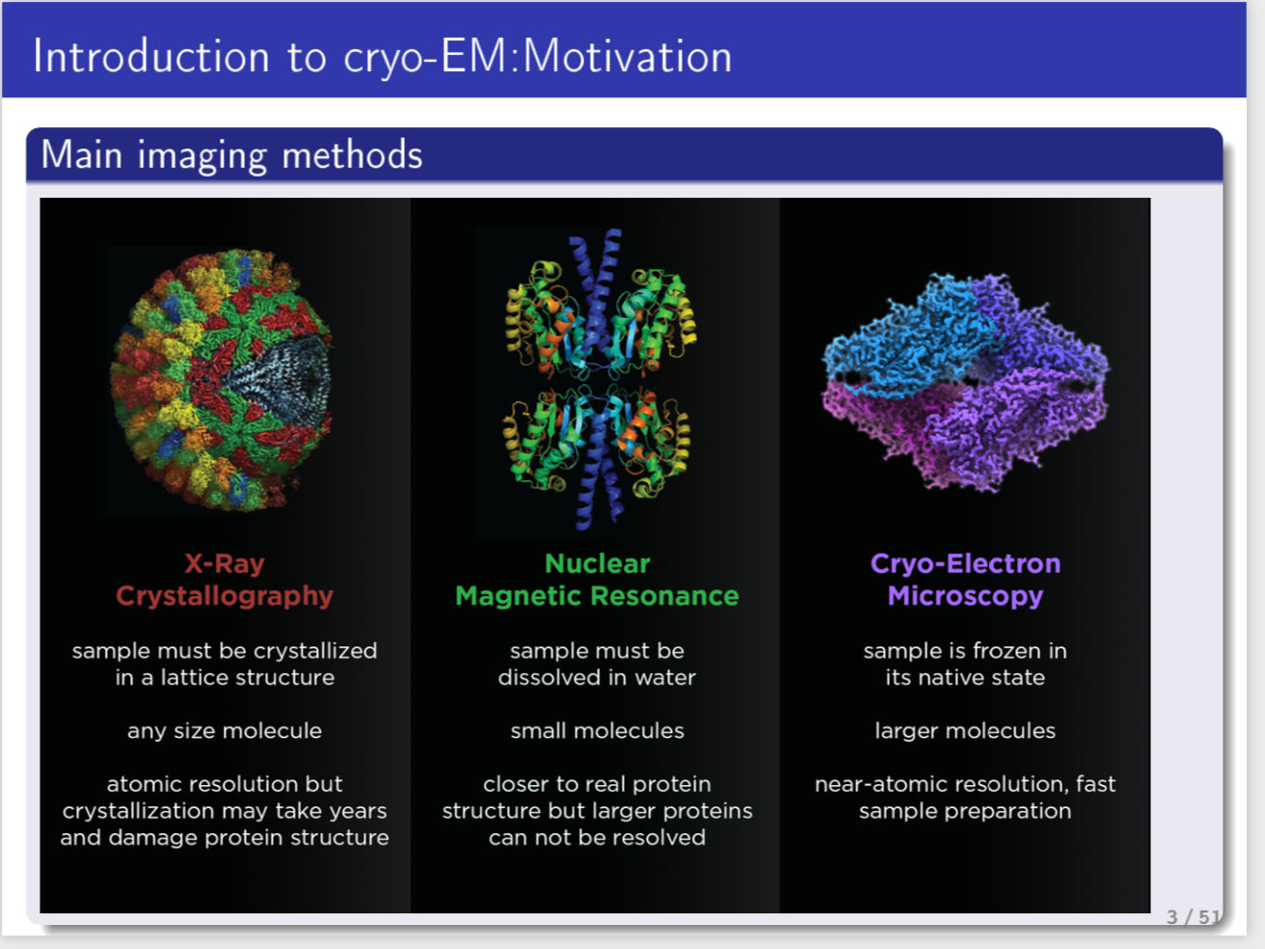
INTRODUCTION: GENERAL
cryo-EM

Slide 5
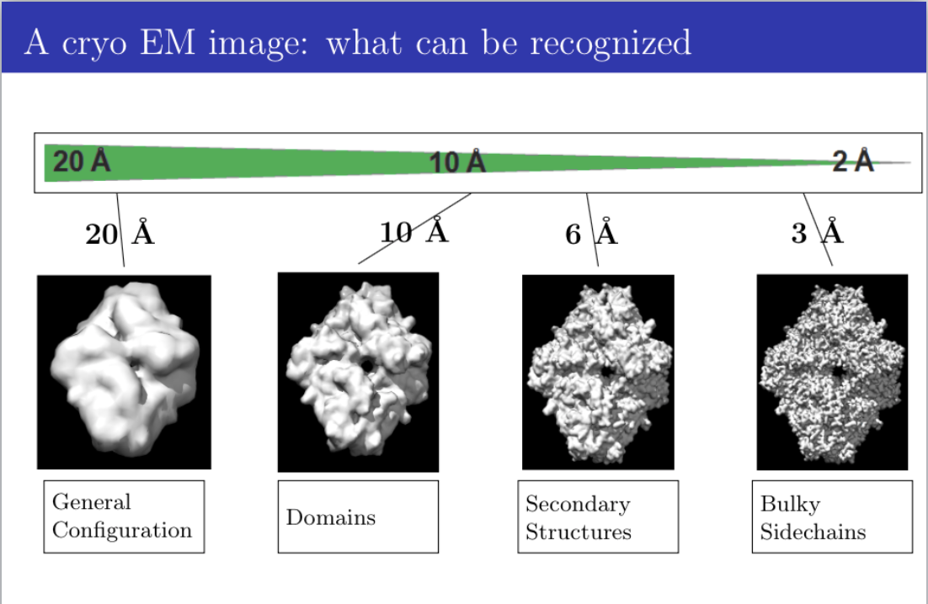
donec quis nunc

Slide 6
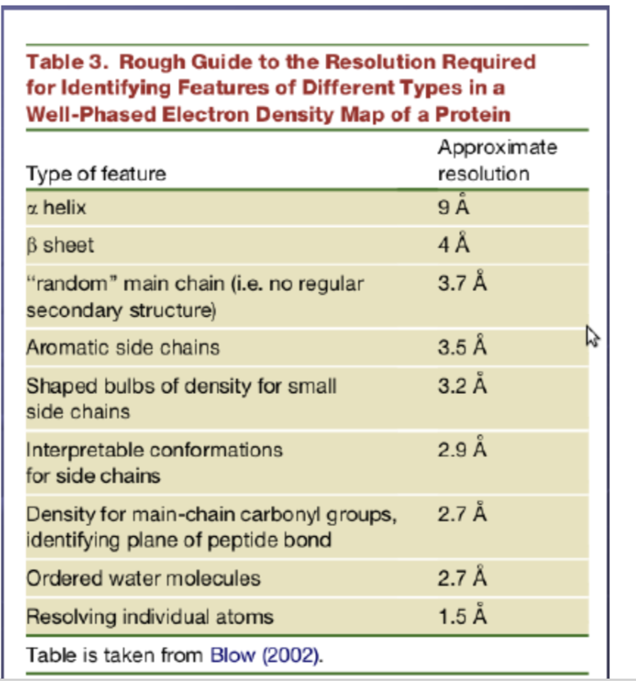
Introduction
Cryo-em

Slide 7
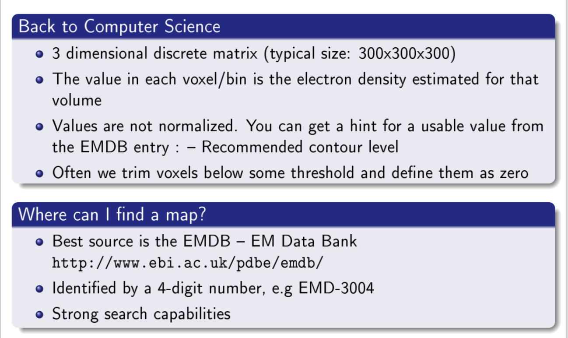
INTRODUCTION
CRYO-EM

Slide 8
INTRODUCTION : PROPOSED RESEARCH
DEVELOP DEEP LEARNING ALGORITHMS FOR LOCATING STRUCTURAL MOTIFS in CRYO-EM maps OF HIGH AND MEDIUM RESOLUTION
CNN for detection of Amino Acids in High Resolution maps
CNN for annotation of Secondary Structures in Medium Resolution maps
CNN for detection of Binding Sites in Medium Resolution maps

Slide 9
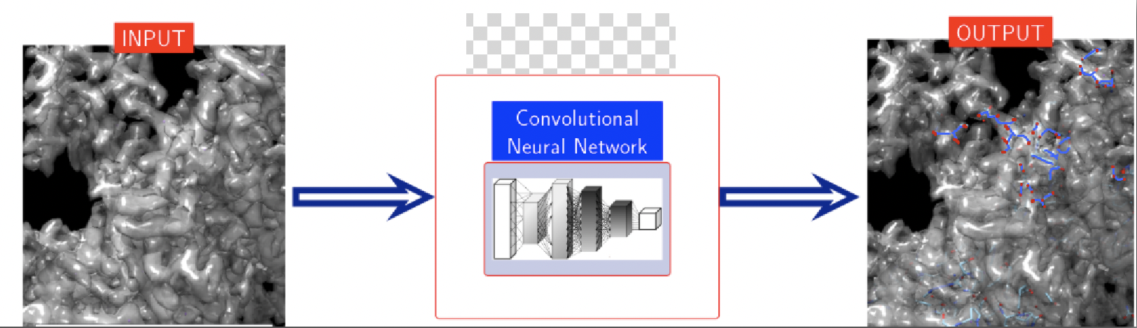
RESEARCH GOALS
Develop a tool for extracting structural information from a cryo-EM map at various resolutions
Use Deep Learning Techniques
Integrate Sequence and Structural Information

Slide 10
RESEARCH GOALS
APPLY DEEP LEARNInG ALGORITHMS FOR LOCATING STRUCTURAL MOTIFS in cry0-EM MAPS
OVERVIEW
Detection of anchor amino acids in high resolution cryo-EM density maps
Preliminary Results : AAnchor
Annotating Secondary Structure in Medium Resolution cryo-EM maps
Detection of binding sites (BSs) in Medium Resolution cryo-EM density maps
Simulating cryo-EM maps using Generative Adversarial Network
Preliminary Results : Deep Map Simulation

Slide 11
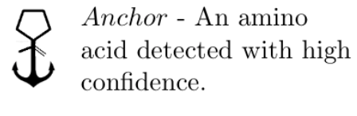
RESEARCH GOALS
Detection of anchor amino acids in high resolution cryo-EM density maps
INPUT: cryo-EM map, sequence
OUTPUT: location of amino acid anchors
MOTIVATION:
Anchors can guide various de-novo modelling methods
Useful in refinement and evaluating of existing models

Slide 12
RESEARCH GOALS
Detection of anchor amino acids in high resolution cryo-EM density maps
Apply classification CNN
Lack of experimental data
Utilize X-ray Data
Domain Adaptation
Create Realistic cryo-EM simulation

Slide 13
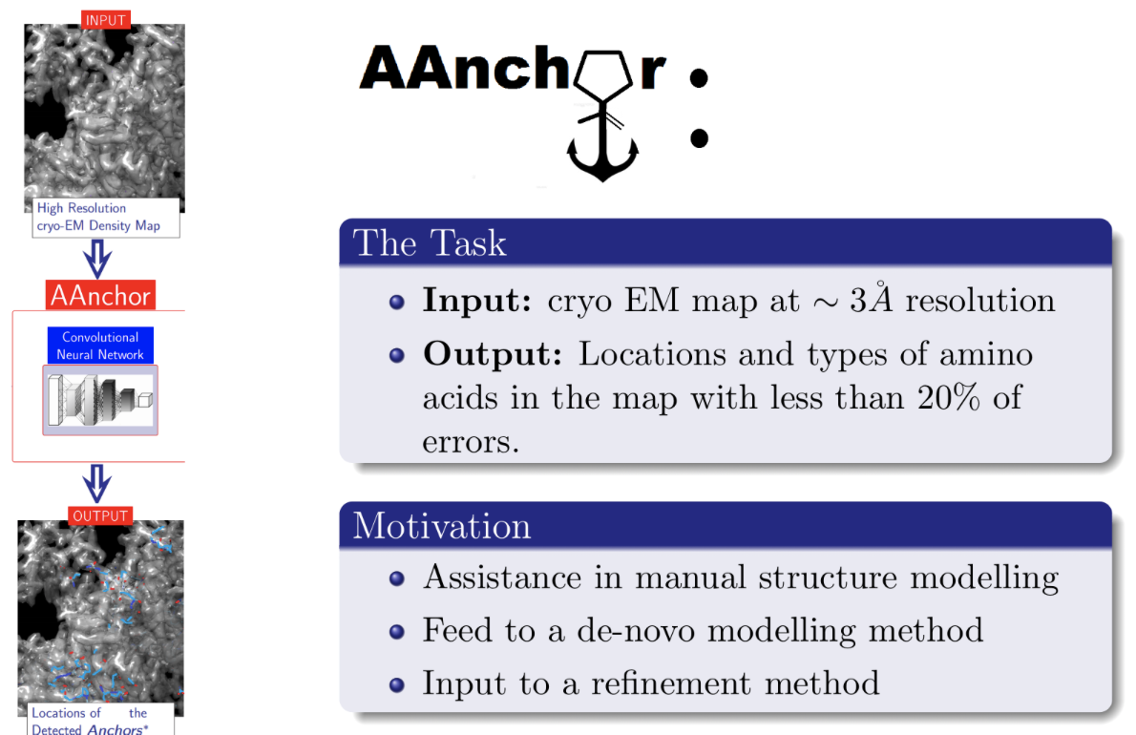
PRELIMINARY RESULTS
AANCHOR

Slide 14
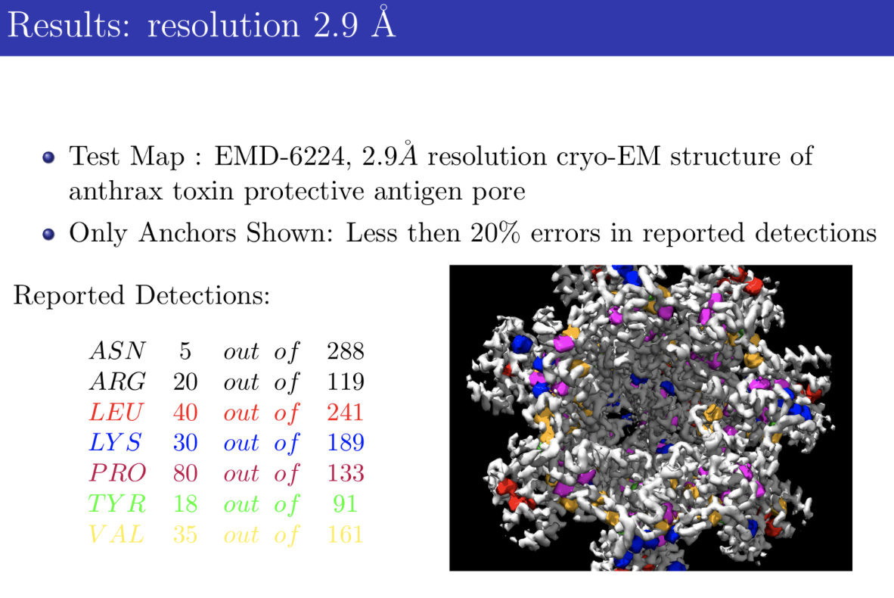
PRELIMINARY RESULTS
AANCHOR

Slide 15
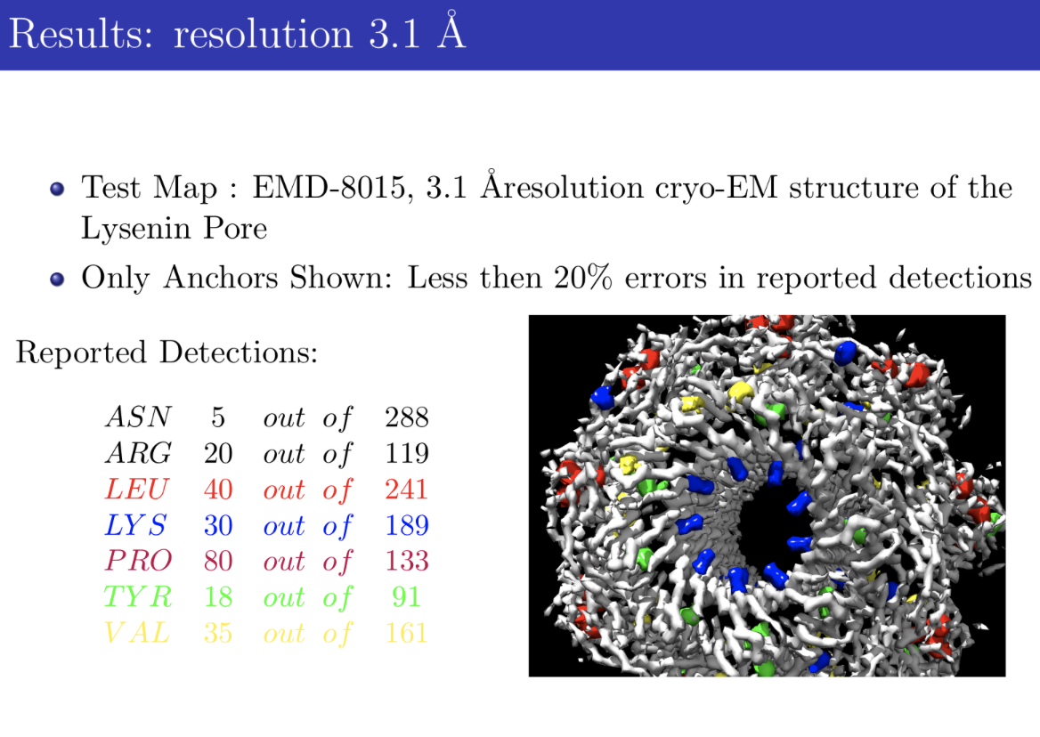
PRELIMINARY RESULTS
AANCHOR

Slide 16
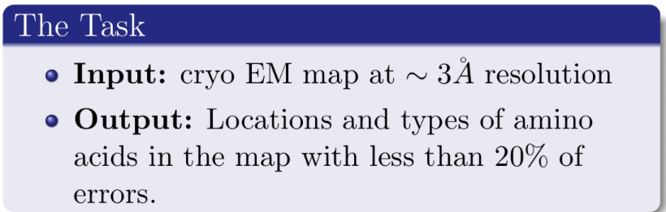
FUTURE RESEARCH
HIGH RESOLUTION:
LOCATING AMInO ACIDS
CLASSIFICATION CNN
AANCHOR PERFORMANCE IMPROVEMENT
Use X-ray crystallography Data
Realistic cryo-EM simulation

Slide 17
FUTURE RESEARCH
HIGH RESOLUTION:
LOCATING AMInO ACIDS
ADVANTAGES
Sequence information is utilized in the anchor location task.
Using homolog structures ensures that the training dataset and the query map have similar feature distributions.
Training datasets of arbitrary size can be created.

Slide 18
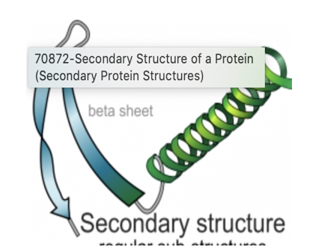
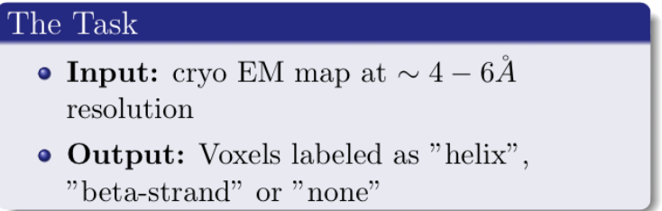
RESEARCH GOALS
ANNOTATING SECONDARY STRUCTURES in MEDIUM RESOLUTION MAPS
Use Fully Convolutional NN
Integrative method : Sequence data is used for creating a dataset which is based on structural homologs

Slide 19
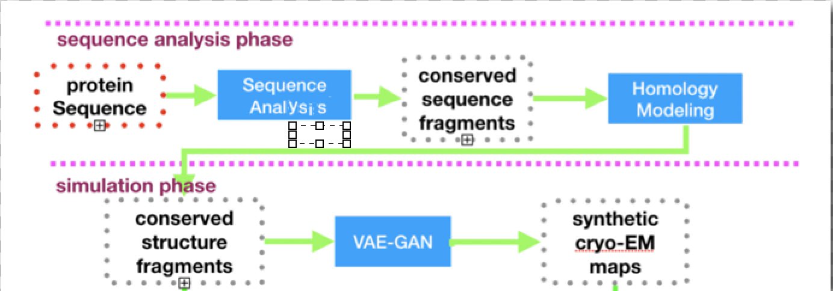
RESEARCH GOALS
ANNOTATING SECONDARY STRUCTURES in MEDIUM RESOLUTION MAPS
CREATE TRAINING DATASET WITH SIMILAR FEATURES DISTRIBUTION
USE SEQUENCE DATA
Find Sequence homologs
Extract \Create Structures
Simulate Cryo-EM map
￼

Slide 20
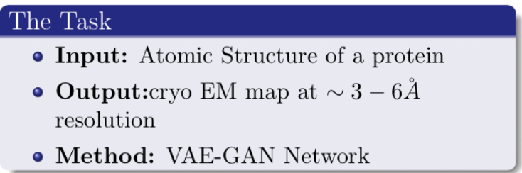
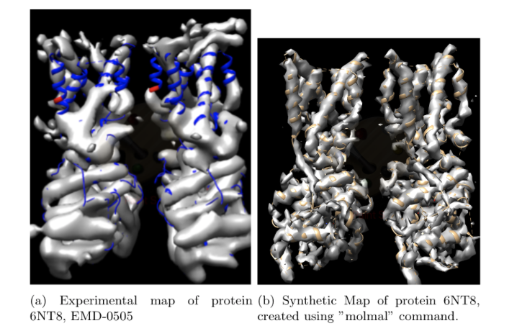
PRELIMINARY RESULTS
DEEP MAP SIMULATION- MOTIVATION
High Demand for realistic cryo-EM simulation
Existing “molmap (pdb2mrc)” program represents ideal universe
Can be integrated in semi-supervised learning strategies.

Slide 21
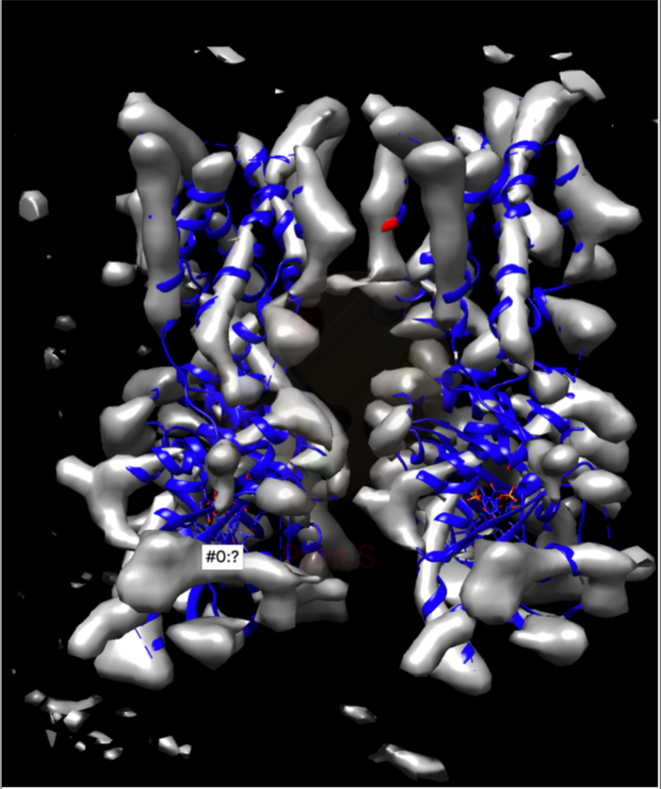
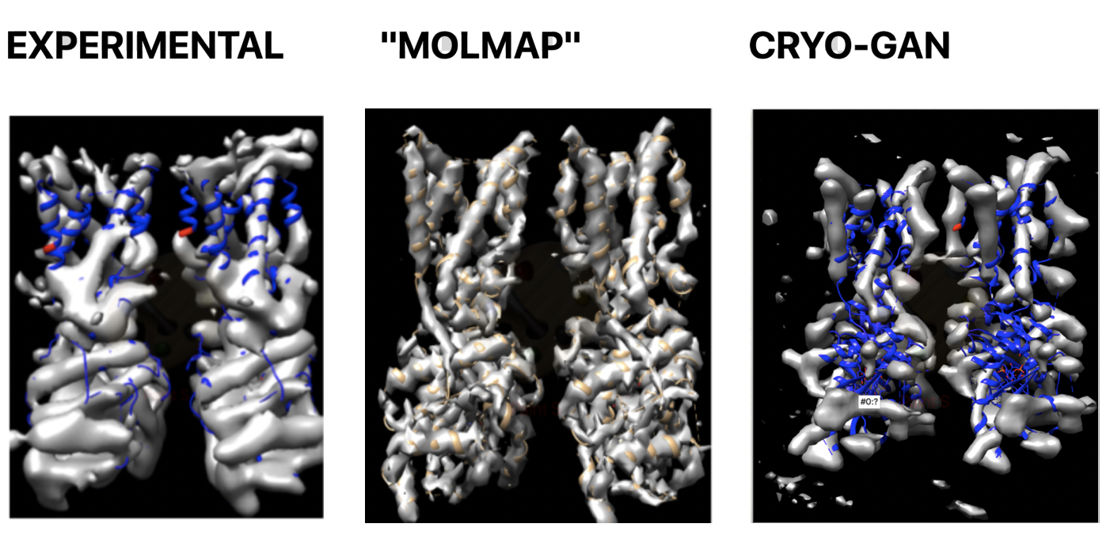
PRELIMINARY RESULTS
SYNTHETIC MAP
Evaluation of the map generated by cryo-GAN is performed by running the evaluation discriminator on each voxel of the map.
56 % of the cryo-GAN map voxels were labeled as "real".

Slide 22
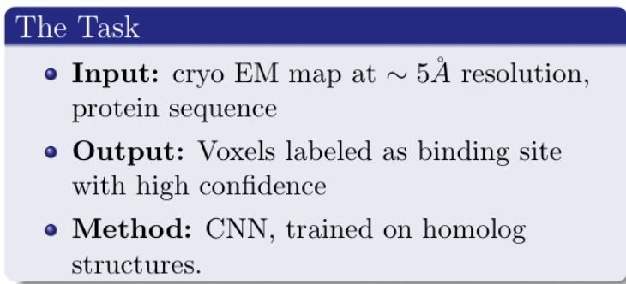
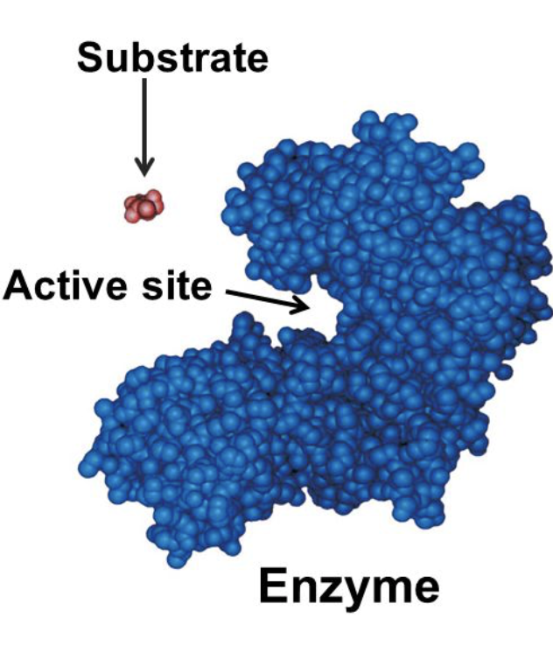
RESEARCH GOALS
DETECTION OF BINDING SITES in MEDIUM RESOLUTION
BINDING SITES DICTATE MOLECULAR FUNCTION
Less Flexible -> easy to find
Conserved in evolution -> more training data

Slide 23
RESEARCH GOALS
DETECTION OF BINDING SITES in MEDIUM RESOLUTION
Integrative Algorithm for finding binding sites in cryo-EM maps

Slide 24
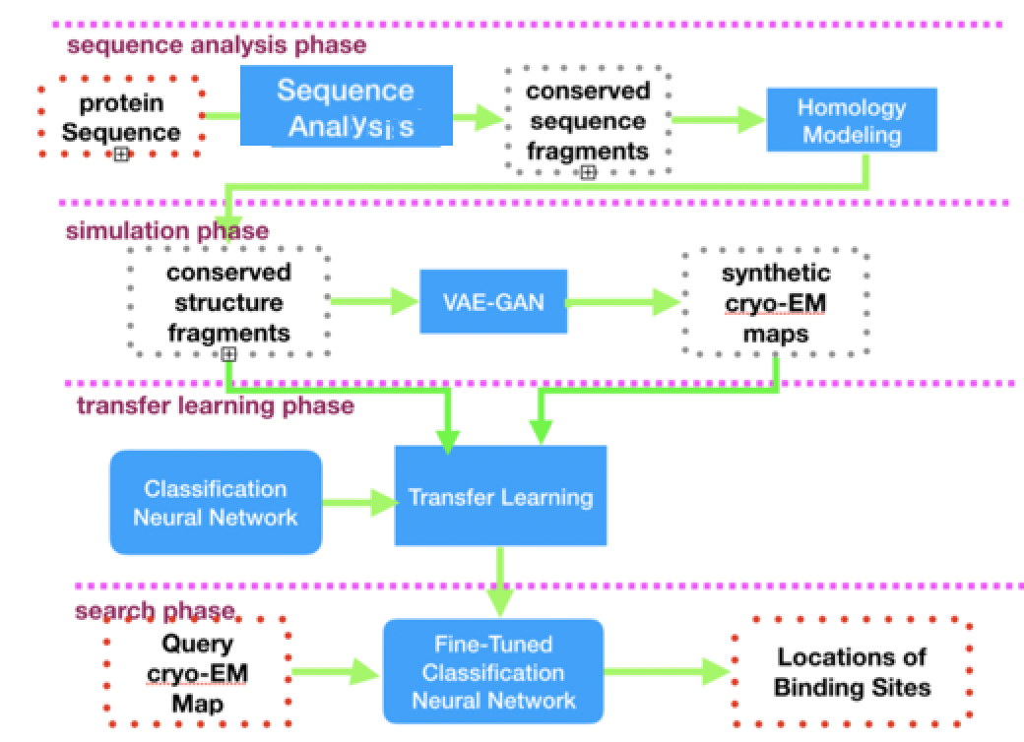
FUTURE RESEARCH
MEDIUM RESOLUTION
LOCAtING BINDING SITES
FOUR pHASED ALGORITHM

Slide 25
FUTURE RESEARCH
MEDIUM RESolution:
ANNOTATING SECONDARY STRUCTURES
(SEMANTIC SEGMENTATION)
SEQUENCE ANALYSIS - obtain sequence homologs
MODELLING - extract structures of the homologs from PDB
SIMULATION - create cryo-EM maps of homolog structures
TRANSFER LEARNING - perform fine tunning of the pretrained CNN
SEARCH PHASE - use fine tuned CNN to locate binding sites

Slide 26
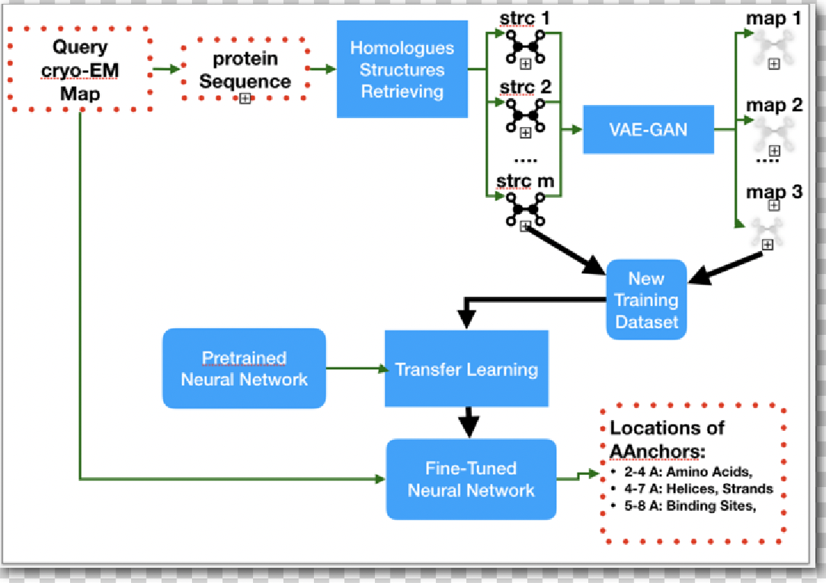
FUTURE RESEARCH
CREATE TRAINING DATASET WITH SIMILAR FEATURES DISTRIBUTION
SEMI SUPERVISED LEARNING

Slide 27
sUMMARY
Proposed a number of DL methods for analysis of cryo-EM maps
The proposed methods integrate structural and sequence information
The proposed methods can be used for obtaining an atomic model and revealing its functionality
Final Effort - develop an integrative method for ab initio modelling.

